Slide 1
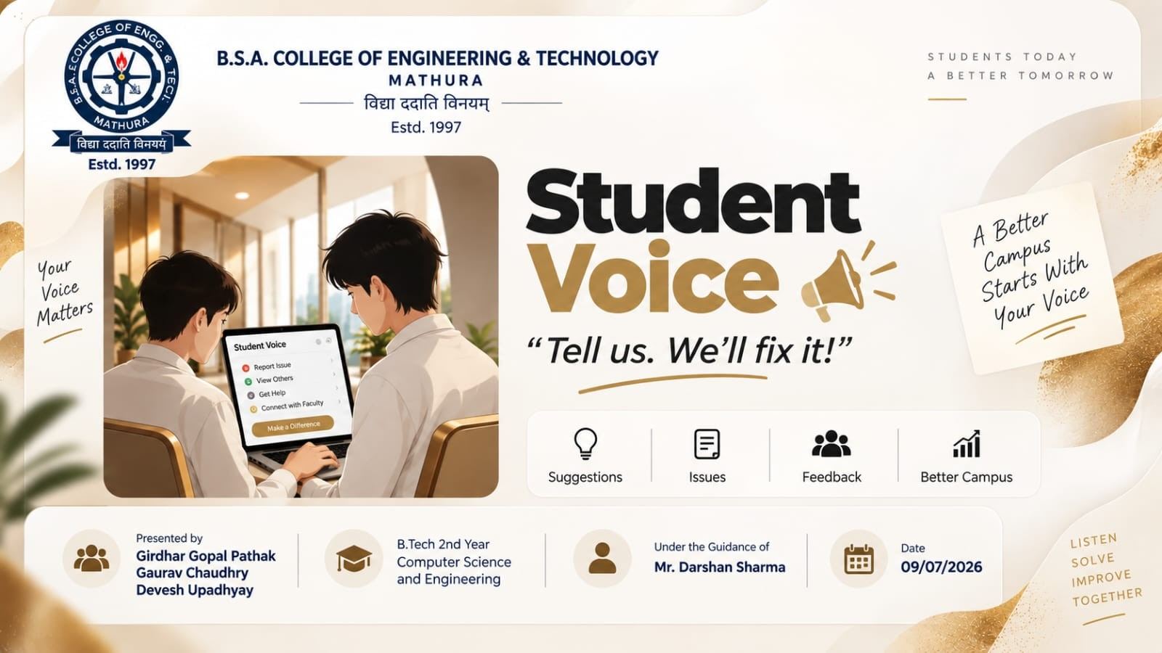

Slide 2
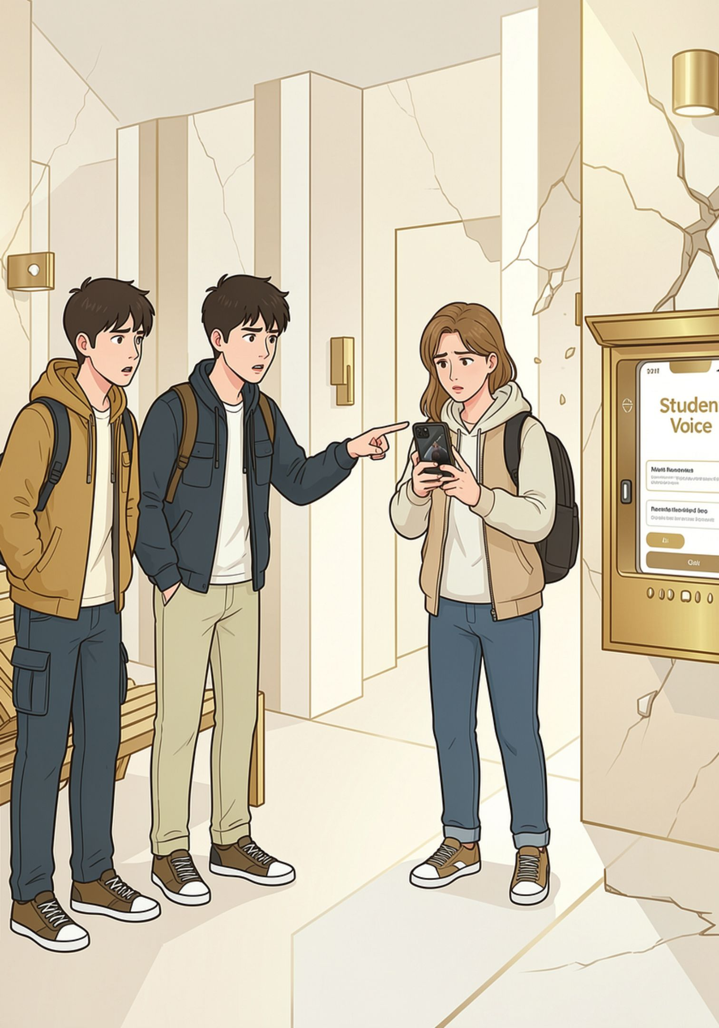
Student Voice
A real-time, portal-based chat system that lets students raise problems, find others facing the same issue, and reach teachers directly.

Slide 3
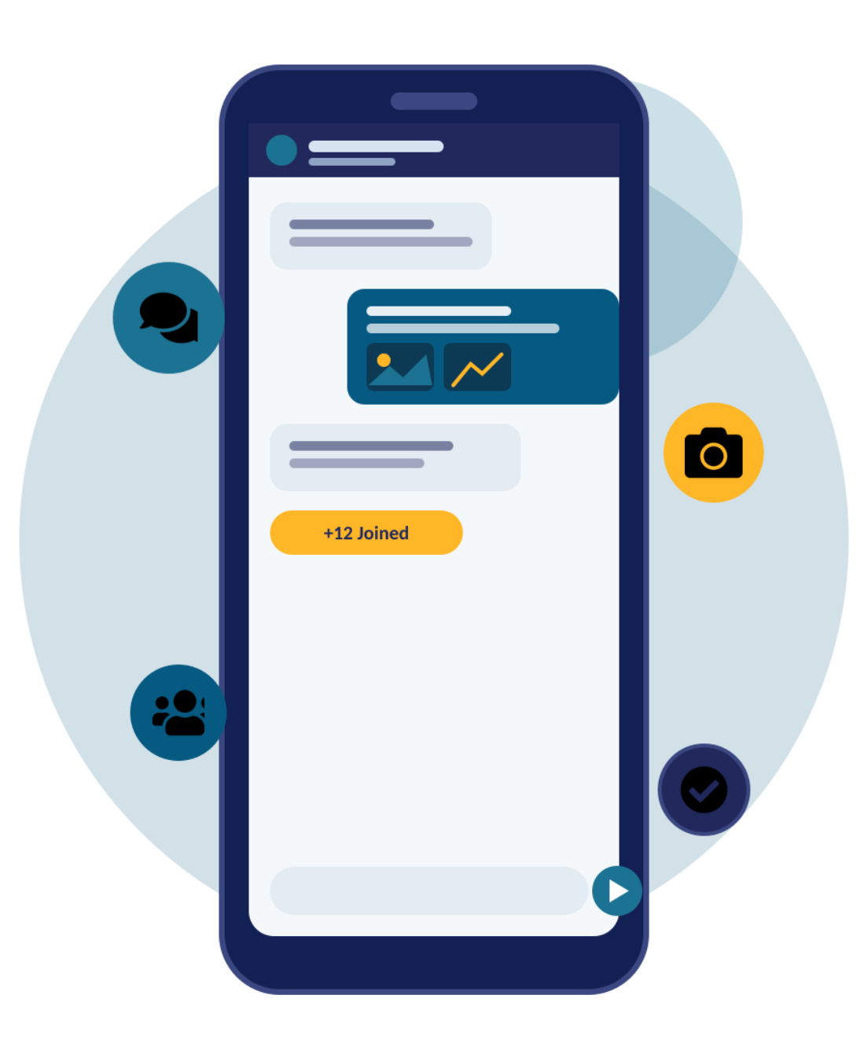
🔴 The Problem
Students are not being heard
No proper channel to report issues directly to faculty
Genuine issues ignored due to lack of visibility
Sensitive topics need a safe, gender-specific space
Some matters require private teacher conversations

Slide 4

👥 Team Members
The Builders
Gaurav Chaudhary
Girdhar Gopal Pathak
Team Member
Team Member
devesh upadhyay
mr. darshan sharma
team member
Guided by: Concerned Faculty Mentor

Slide 5
💡 Project Overview & Objectives
Secure Login
Four Portals
College ID + verified profile
Public, Boys, Girls, Personal
Real-Time Chat
Join & Prioritize
Direct faculty communication
Students back issues to surface priorities
Gender-Safe Space
Private Line
Separate portals for sensitive topics
One-on-one teacher conversations

Slide 6
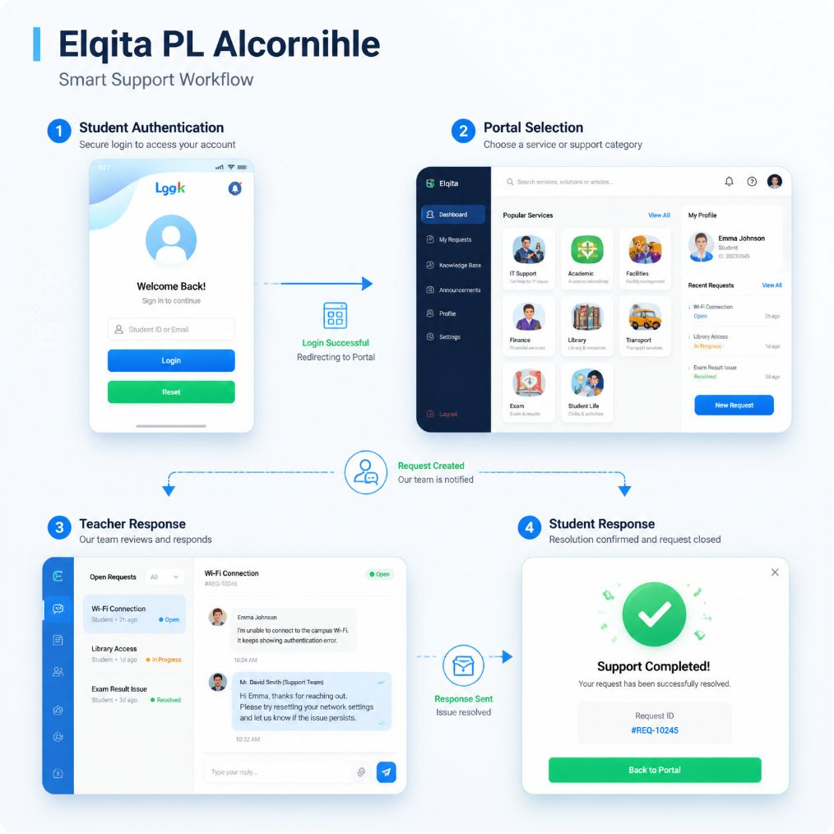
⚙️ Algorithm & Methodology
01
02
Login
Choose Portal
Student logs in with College ID & fills profile
Public / Boys / Girls / Personal
03
04
Post & Engage
Teacher Responds
Post problem → others join → priority ranked
Reviews issue & replies in real-time chat
05
Resolved ✅
Issue marked resolved for all

Slide 7
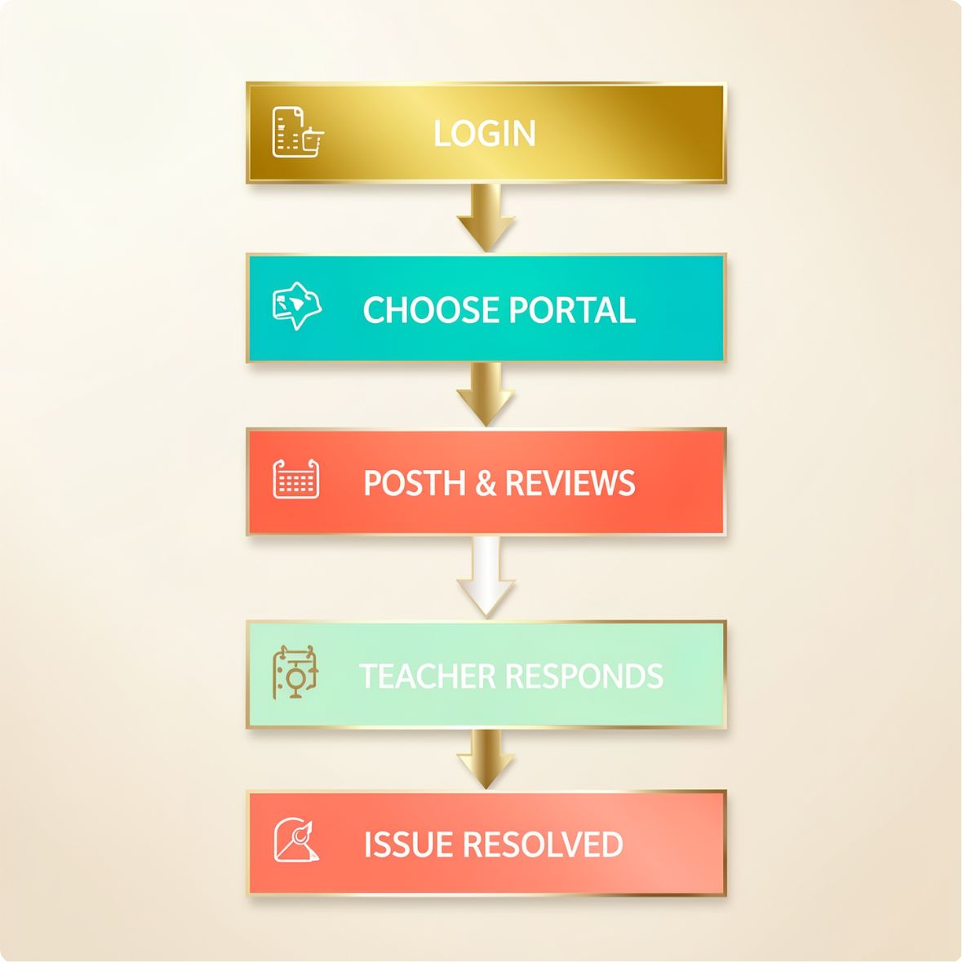
🔄 Flowchart
1
2
LOGIN
CHOOSE PORTAL
Student accesses portal with College ID
Select Public, Boys, Girls, or Personal
3
4
POST & ENGAGE
TEACHER REVIEWS
Post problem, others join and upvote
Faculty reviews the issue
5
6
TEACHER RESPONDS
ISSUE RESOLVED
Real-time chat response
Problem marked as resolved

Slide 8
🛠️ Technologies & Tools Used
Frontend
Backend
HTML5, CSS3, JavaScript
Python (Flask)
Database
Version Control
MySQL
GitHub
Development
Testing
VS Code
Google Chrome

Slide 9
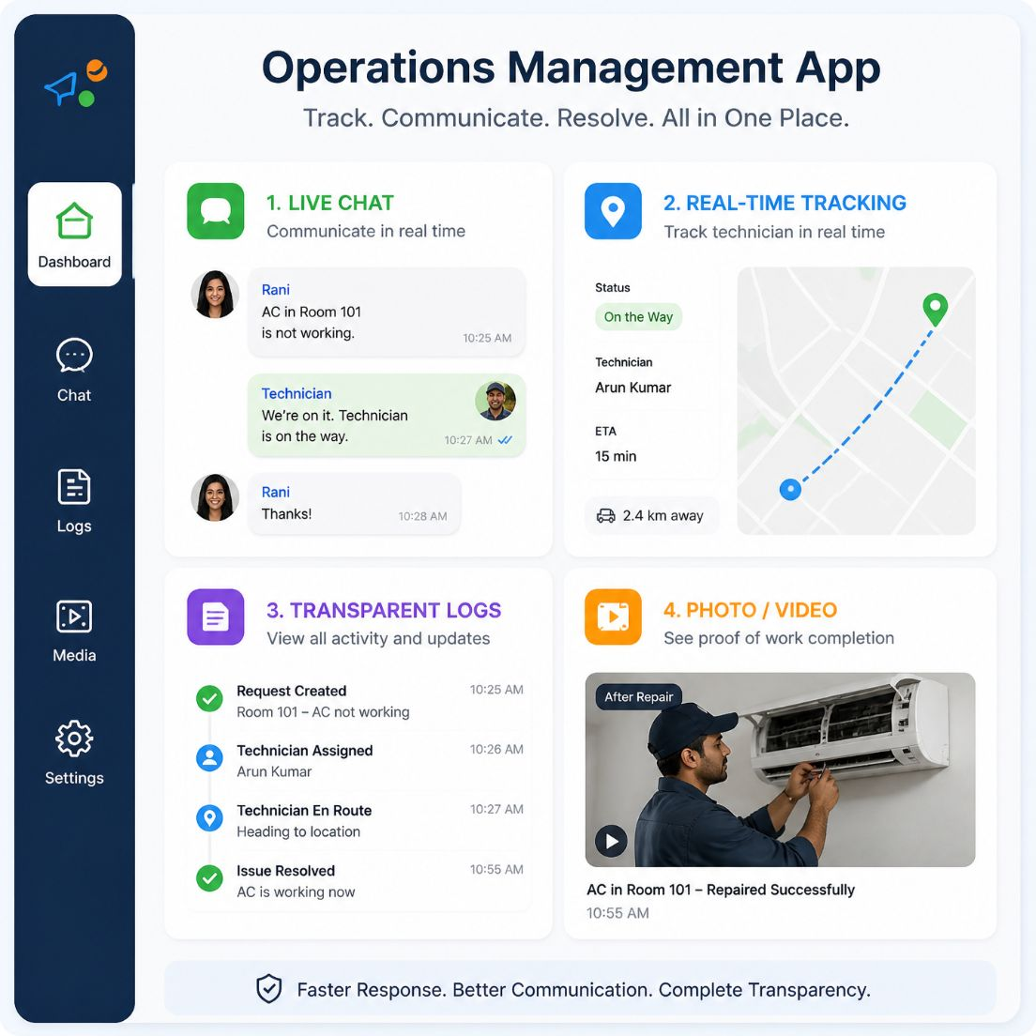
📋 Expected Outcome & Features
⚡ Live Chat
📡 Real-Time Tracking
🔍 Transparent
Faster than static forms
Every issue logged & traceable
Instant status updates
📎 Photo/Video
Attach evidence for clarity

Slide 10






📈 Future Scope
📱 Mobile App
🤖 AI Assistant
📊 Analytics
🔔 Smart Alerts
Android & iOS access
Smart suggestions & replies
HOD insights on issues
Push & email notifications
🌐 Multi-Language
🔒 Advanced Security
Regional language support
End-to-end encryption

Slide 11
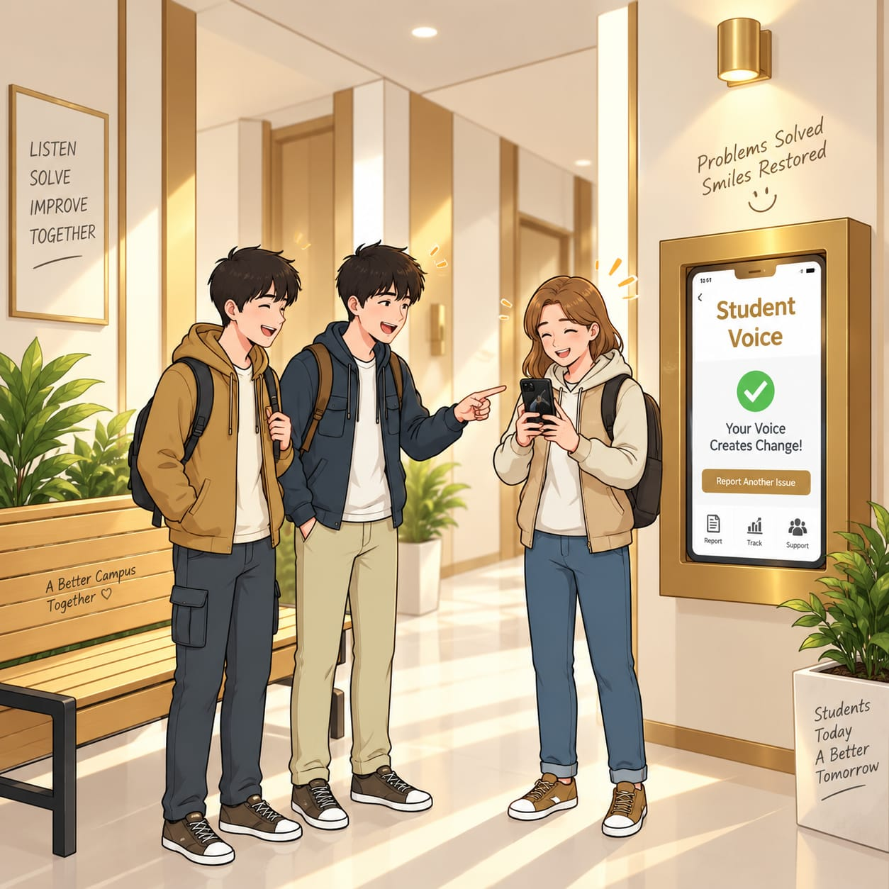
✨ Impact & Conclusion
A faster, transparent, and accountable system for student grievances — no office visits required.
Student Voice empowers every student to be heard and ensures no genuine issue goes unaddressed.
🎯 Every Voice Heard
⚡ Faster Resolution
No student is left unheard
Real-time over paperwork
🔍 Full Transparency
Every issue logged & tracked

